Slide 1
Specialty films
“PRODUCED IN EVERY IMPORTANT CITY IN THE WORLD”:
Filling the void left by the Edison Trust
2020 DOMITOR CONFERENCE
** Gwendolyn Waltz **
→To access websites and videos in this presentation, use full screen mode and click on the orange links in the blue boxes.←
For permission to reproduce or share this presentation, please contact me: gwendolynwaltz@gmail.com

Slide 2
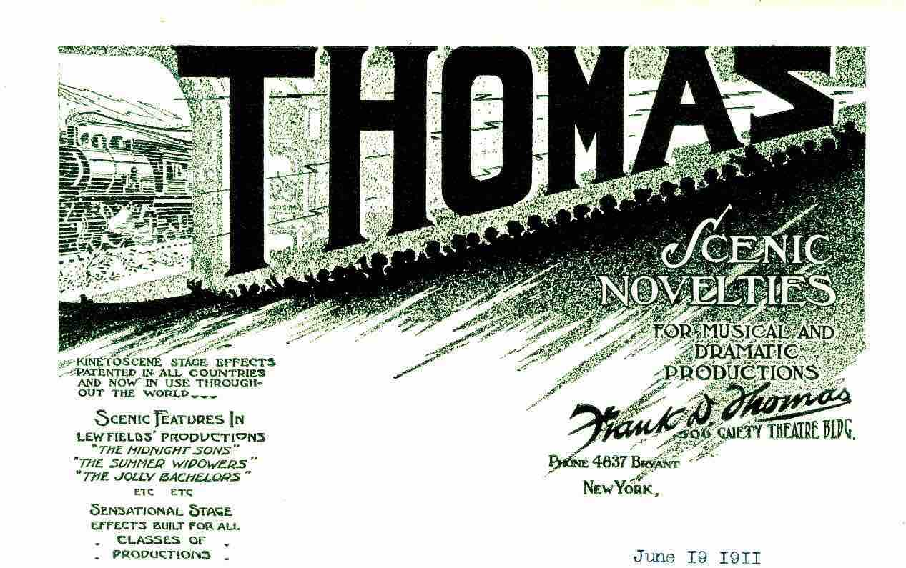
Used with permission of the Shubert Archive
“THOMAS.” The thick letters emanate along lightning-like rays of a motion-picture projector’s beams, over the silhouetted heads of audience members in a raked auditorium, some of whom raise their hands in excitement at the image of a racing locomotive displayed on the screen before them. It is an illustration on one of the letterheads in the General Correspondence files at the Shubert Archive, used by Frank D. Thomas, the creator of “KINETOSCOPE STAGE EFFECTS PATENTED IN ALL COUNTRIES AND NOW IN USE THROUGHOUT THE WORLD,” as described by his stationery in 1911-1912.

Slide 3
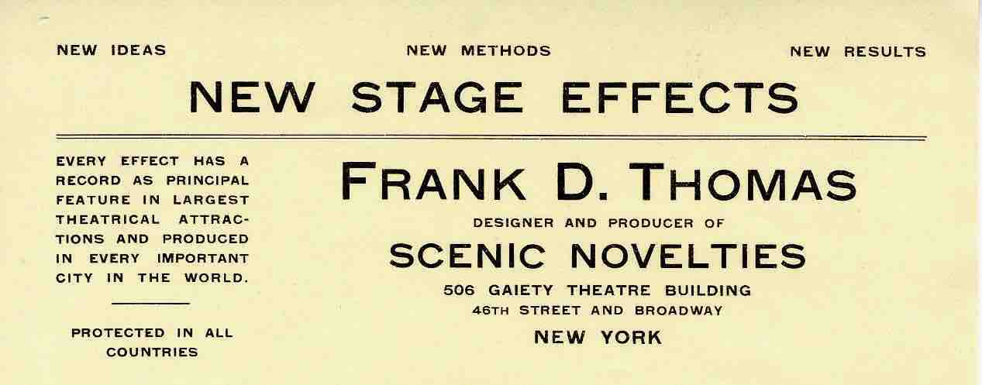
“NEW IDEAS . . . NEW METHODS . . . NEW STAGE EFFECTS . . . PROTECTED IN ALL COUNTRIES”: his simpler letterhead the following years re-emphasized his legal claim.
Used with permission of the Shubert Archive
In subsequent years, stationery was headed with lists of effects created by his “SPECIAL MOTION PICTURES MADE FOR ALL PURPOSES.”
Used with permission of the Shubert Archive

Slide 4
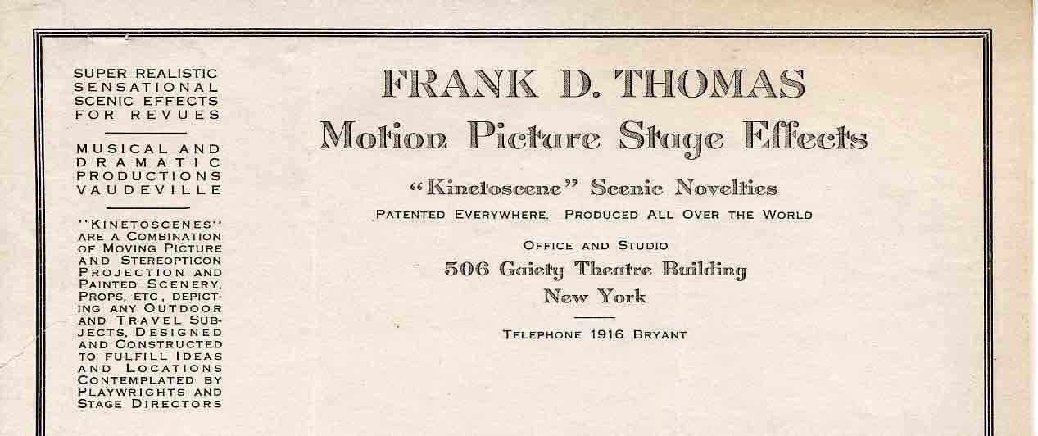
After World War I, he identified his business more directly—producing “Motion Picture Stage Effects”—and described his “Kinetoscenes.” →
Used with permission of the Shubert Archive
Just as the Motion Picture Patents Company and its associated distribution agencies were forming—and just as, in the United States, the members of these companies were withdrawing from the modest sideline business of making films to be integrated multimedially with stage performances—Frank D. Thomas and his professional partner, George Layton, established their “motion picture stage effects” business after collaborating on similar work with Edwin S. Porter at Edison Studios.

Slide 5
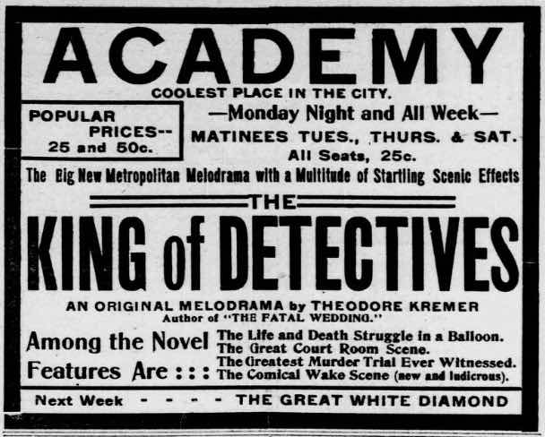
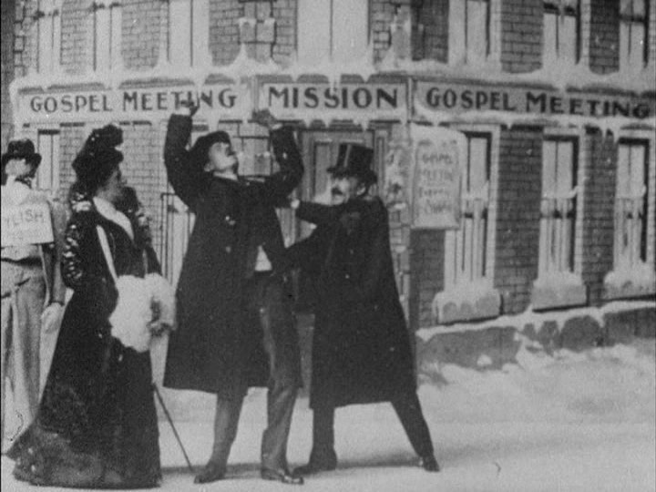
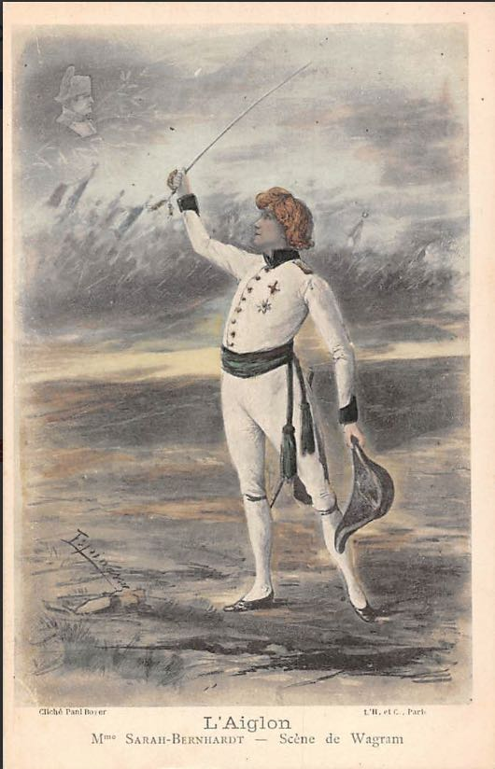
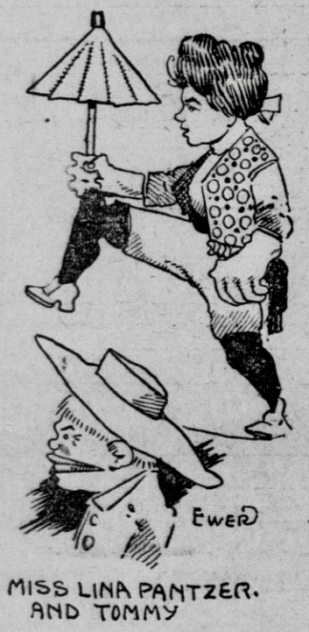
So far, I have counted over one hundred specialty films made internationally between 1896 and 1908 for theatrical artists and producers. Variously, these were inserted between live action scenes in melodramas and musical revues, used as moving-picture background scenery, played a role in dramatic court room and music hall scenes,
or they took the form of song films accompanied by singers, special effects for dancers or funambulists . . .

Slide 6
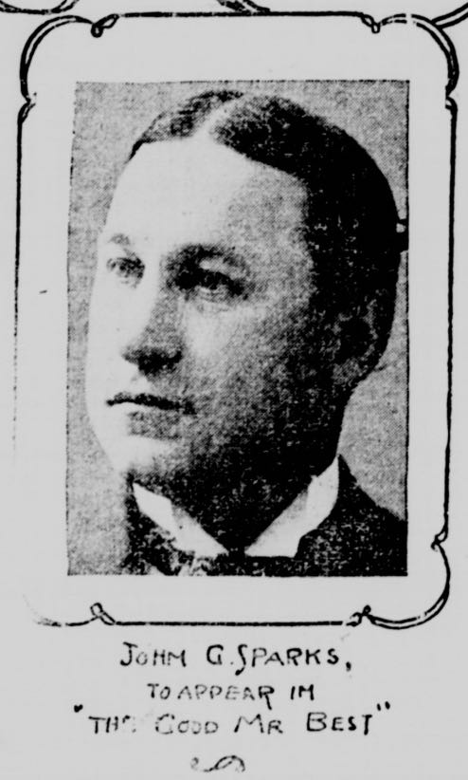
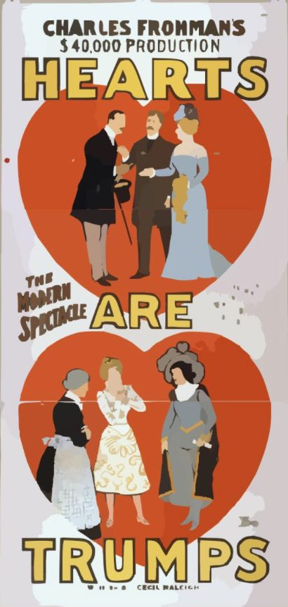
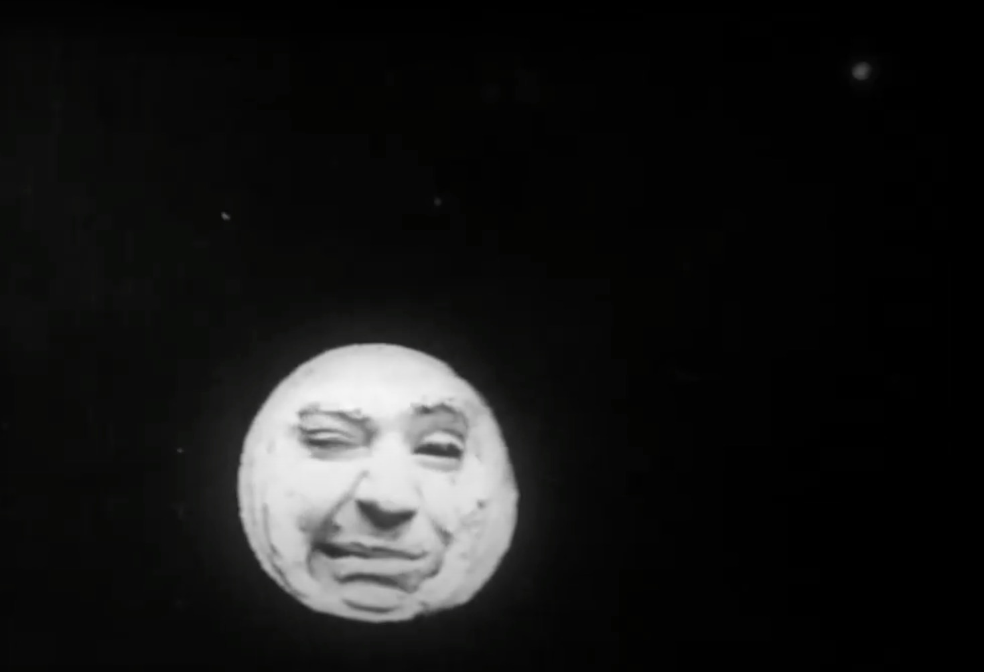
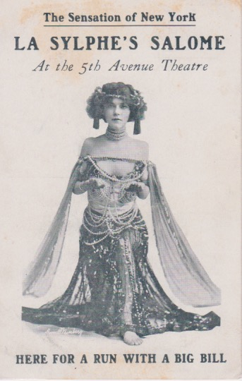
. . . comic dressing-room films which covered costume changes, entertaining entrance films about an artist’s wild journey to the theatre, filmed characters who seemed to interact with living ones, magic illusions, unique lectures, and motion-picture prologues preceding live action.

Slide 7
Although many of the producers of these moving pictures have yet to be identified, major filmmakers and companies were involved.
Gaumont ~ Georges Méliès ~ Louis Gasnier ~ Oskar Messter ~ Prosynski Pierograph ~ Nederlandische Mutoscope and Biograph ~ British Mutoscope and Biograph ~ Charles Urban ~ Liverpool Cinematograph Syndicate ~ Mitchell and Kenyon ~ American Mutoscope and Biograph ~ William Paley ~ Edison Studios ~ Siegmund Lubin ~ George Kleine
However, in the United States, it is unusual to trace multimedia films directly to major film companies after 1908. Apparently, this theatrical sideline business ended abruptly. Charles Musser describes the probable reason:
“Laying out rules that regulated the principle components of the industry, the Association of Edison Licensees and the Film Service Association prohibited marginal film practices. The production of industrials, advertising films . . . and special comedies like those made for Lew Dockstader [by Edwin S. Porter] was apparently no longer permitted. Local actuality subjects could not be made or handled by members of the Film Service Association, pushing nonfiction filmmaking even further to the margins.” (Before the Nickelodeon, pp. 378-379)
In spite of this prohibition, demand for these films in the American theatre continued and increased. Someone was needed to fill the void. Enter, Frank D. Thomas.

Slide 8
While, in the past, I have written about filmed scenery and Thomas’s patents, more recently I uncovered information connecting him to the Edison Studios, Edwin S. Porter, Jean C. Havez (best known as a writer for Keaton, Arbuckle, and Lloyd), George Layton (a stage electrician and “biograph operator” who partnered on Thomas’s effects), and Lew Dockstader (a well-known blackface minstrel performer). Like the majority of people involved with the early 20th century American entertainment industry, all of these men participated in minstrel shows and variety acts promulgating derogatory racial, ethnic, and gender stereotypes.
How extensively minstrelsy’s white supremacist tropes were acted out as interpersonal prejudice and discrimination often is more complicated to decipher. For instance in 1909, Frank Thomas established his business in the newly-built Gaiety Theatre Building—a racially integrated space sometimes called “Black Tin Pan Alley.” Its owner, George M. Cohan, rented to African American composers who were barred from having offices in the Brill Building with white music publishers who—once theatre development moved up Broadway—had relocated north as the Tenderloin district of the original Tin Pan Alley was abandoned. (At the same time, in spite of his integrated rental approach, it should be noted that Cohan, with Sam Harris, was the producer of a “high class” minstrel show in 1908-1909 . . . which employed Jean Havez.)
Although race is not the focus of my presentation, I believe it is important to acknowledge the probably unquestioned complicity of the people under study, and to earmark this page of multimedia research to be included in larger cultural discussions about blackface, minstrelsy, and systemic racism.
Rhae Lynn Barnes’s upcoming book, Darkology: When the American Dream Wore Blackface, follows minstrel shows off the professional stage and into amateur performance, where “from the Civil War to Civil Rights” blackface proliferated as a commonplace entertainment in the armed services, schools and universities, campus fraternities, organizations such as the Elks Club, professional journalist groups—like the Gridiron Club—that included business leaders and politicians as members, and local civic and social groups across the country.

Slide 9
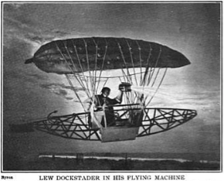
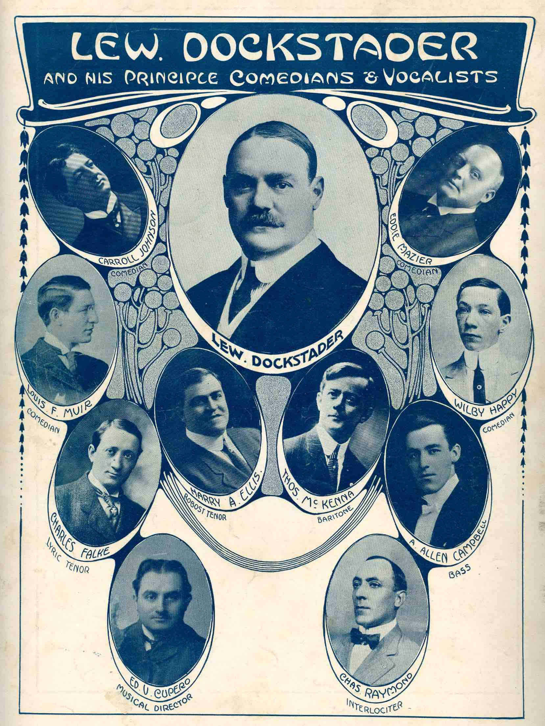
Film historians have discussed three theatrical specialty films made by Edwin S. Porter, all minstrel related, two of them for blackface performer Lew Dockstader. The first was a 1904 film shot in Washington, D.C., in front of the Capitol Building. In performance, Dockstader (live, in blackface) would have tumbled from his flying pickle airship, then the film would have shown President Theodore Roosevelt (singer Harry Ellis in make-up) coming to his aid. (Terry Ramsaye, in A Million and One Nights, devotes six pages to this story.) Meant to accompany the song “Oh, Won’t You Come and Dine With Me?”, federal officials prevented its performance. Charles Musser also describes this and another film that Porter made for Dockstader, which was released by Edison as a stand-alone motion picture in 1908, titled Minstrel Mishaps. Contemporary newspaper articles reveal this to have been a composite of several films used in separate multimedia sketches that Dockstader performed in 1906.

Slide 10
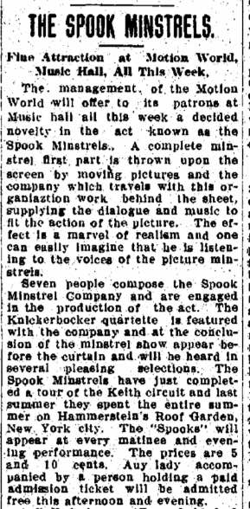
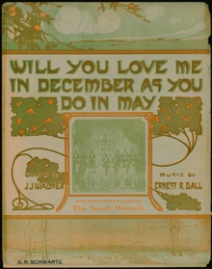
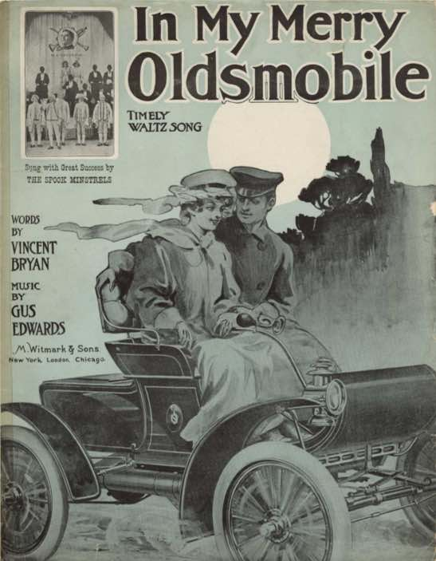
The third film shot by Porter is Spook Minstrels, made for a multimedia vaudeville act written by Jean Havez and W.C. Youngson in 1904, which had a long stage life in the U.S. and Canada from 1905 until at least 1911. Onstage the film was projected, while live performers sang behind the screen and were then revealed for an encore. The film is static, framed to show tiered rows of minstrel performers on a stage. Rick Altman, Charles Musser, Andre Gaudreault, Jasper Aalbers, and others have discussed it.
Articles in the Minneapolis Journal (1905) and Philadelphia Evening Public Ledger (1918) credit the act’s camera operator and manager, George Layton, with conceiving the idea of combining the then-occasional practice of behind-the-screen performance with a filmed minstrel show. The Journal article details Layton’s description of making the motion picture at the Harley Merry scenic studio in Brooklyn, as well as the film’s developing and hand-coloring at the Edison laboratory. The Ledger also brings in Frank Thomas, who “saw greater possibilities in the novelty and financed and developed it.” With Spook Minstrels, we see Porter, Havez, Layton, and Thomas professionally linked together.

Slide 11
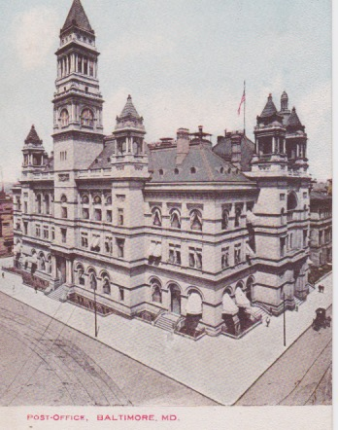
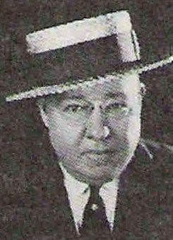
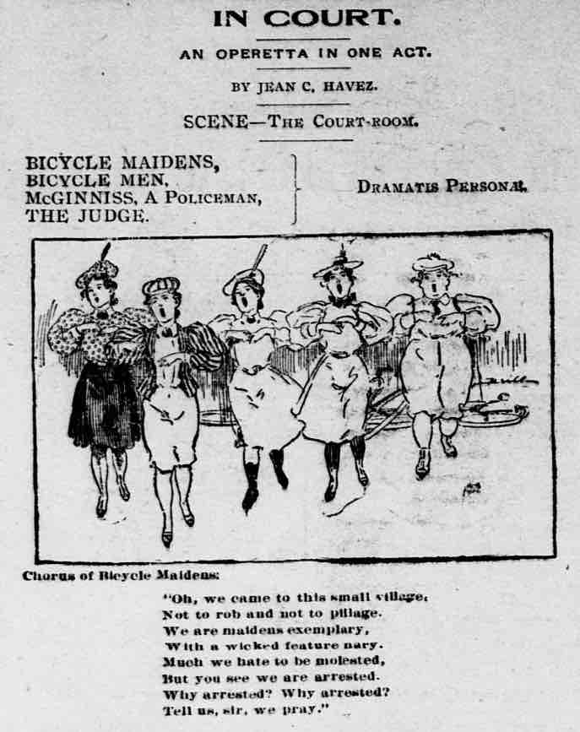
However, relationships among these men began years earlier. By 1900, Frank Thomas and Jean Havez were members of the Journalists’ Club of Baltimore: Thomas as a local building contractor, known for his work on the Baltimore Post Office, completed in 1889, and Havez as a reporter on the Evening News and writer of humorous newspaper pieces and songs. The two men paired as the “joke battery” in the club’s first amateur theatrical, appearing in “burnt cork” in an amateur minstrel show in 1902. They retained a relationship into the 1910s as members of the Friars Club, before Havez left New York to work in Hollywood.

Slide 12
Around 1900, Havez attracted the attention of Lew Dockstader, and by 1903 he was working in press-related capacities for the minstrel while writing comedy pieces and songs. He stayed with the company until 1909. It was during Havez’s tenure that Dockstader incorporated multimedia effects in his shows.
Nine Dockstader films have been identified, made for multimedia sketches between 1903 and 1907; there may have been more. Edwin S. Porter made three to alternate with stage action, using a loose narrative format, and “F.D. Thomas”—described as “the moving picture man” by the New York Telegraph—made two scenic-oriented films introduced late in August 1907. These involved an American flag, fluttering on the screen behind a West Point cadet drill, and a behind-the-screen singing number using aerial films taken by Thomas that somehow were combined “with enlarged heads, each six feet high, of Dockstader and three of his principal comedians.” “Moving pictures cut an important figure in Dockstader’s new exposition of advanced minstrelsy,” the Telegraph reported.
DOCKSTADER
MULTIMEDIA SKETCHES
1903
* Airship effect: “motion pictures and ingenious lighting effects heighten the illusion”(UNATTRIBUTED; style of THOMAS’s scenic effects) *
1904
* Roosevelt scene (PORTER: not used) *
* Dockstader blown from airship to earth by kinetograph (UNATTRIBUTED) *
1906
* Illusion of motorcar trip (UNATTRIBUTED; style of THOMAS’s scenic effects) *
* Dockstader chased by irate passengers: “when the lights are suddenly turned on Dockstader himself is discovered sitting in the mouth of the [water] main just as he was when the picture came to its abrupt conclusion“ (PORTER) *
* Intro to “Editor of the Bungville Corker” telephone sketch: “The biograph depicts his arrival in town, his adventurous ride to the theatre, his making up in the dressing room. Then Dockstader discloses himself as the boss of the city editor’s room” (PORTER) *
* “Love Moon” song: “biograph pictures representing the mobile features of the Girl in the Moon” (UNATTRIBUTED) *
1907
* 15-foot American flag behind West Point cadet drill (THOMAS) *
* Aerial films behind singing heads (THOMAS) *

Slide 13
Questions arise about the Dockstader films:
Four of the nine known films are unattributed. Were these the work of Thomas, of Porter, of both men working together, or of someone else?
Jean Havez surely introduced Frank Thomas to Dockstader and Porter, but when—before Spook Minstrels (1905)?
Did Thomas supply films before 1907 (during the period when Porter can be identified as making Dockstader films)?
Might Thomas have joined with Porter in shooting films, perhaps learning filmmaking from him?
Did Thomas use Edison technicians (e.g., lab, colorists) for his 1907 films?
Did Thomas know/work with Edison employees (e.g., J. Searle Dawley or Norman O. Dawn)? Were they familiar with his work at this time and later?
Was George Layton involved?
When did Thomas become publicly recognizable as “the moving picture man”?

Slide 14
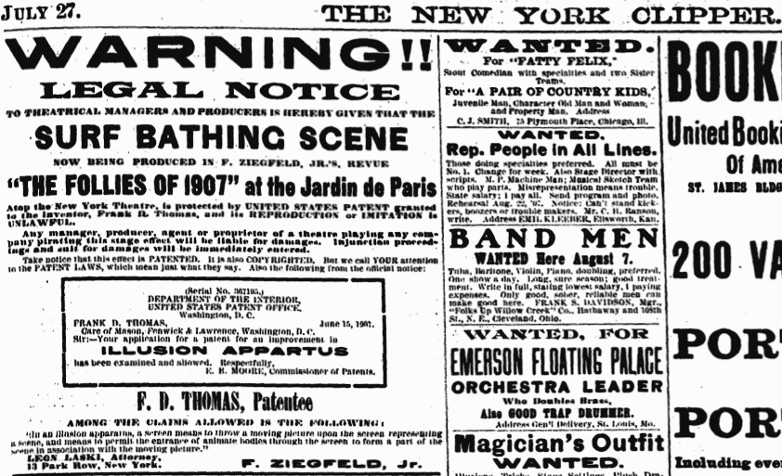
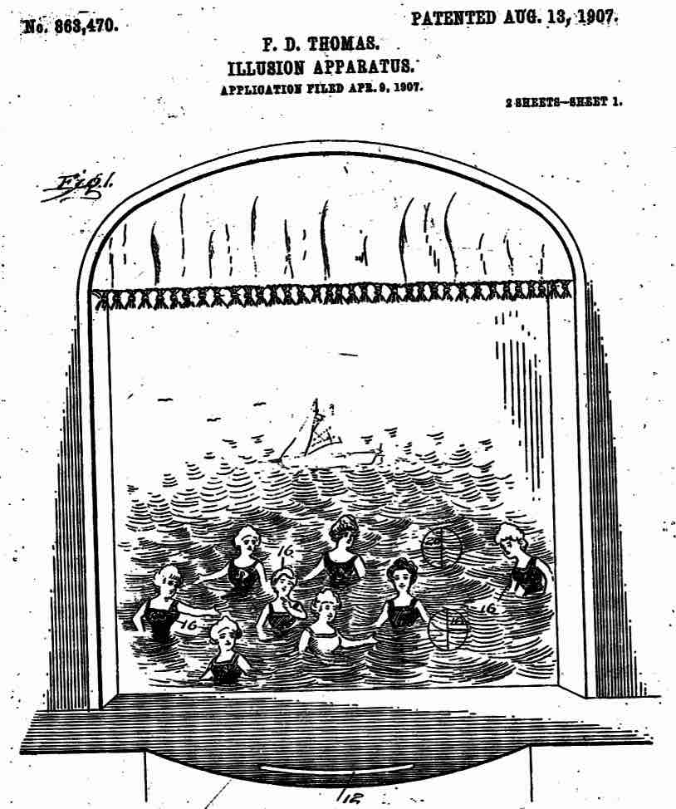
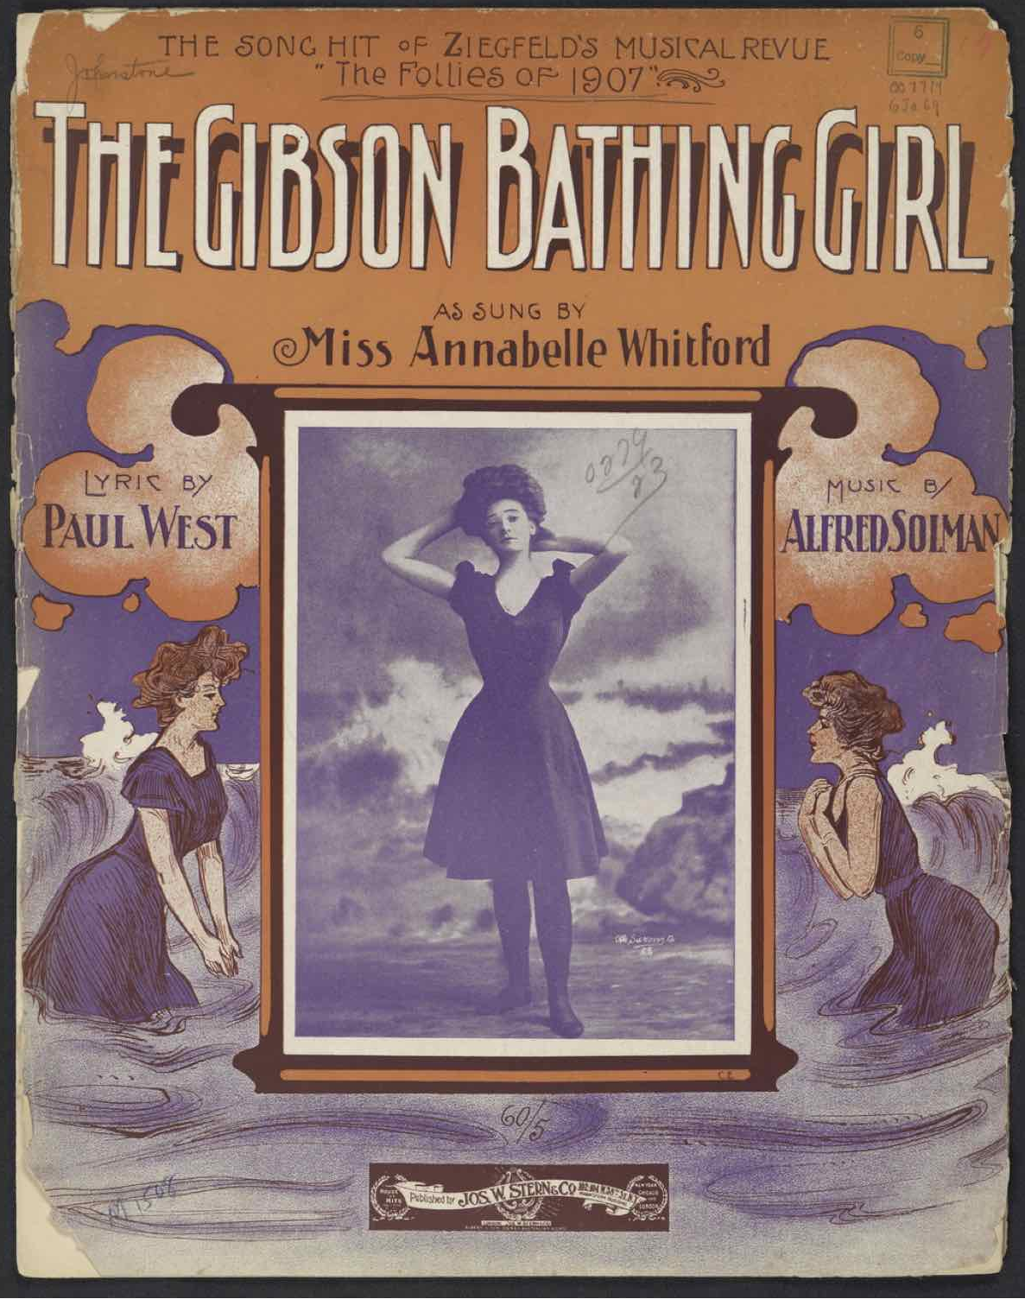
Frank Thomas’s 1907 films for Dockstader may have been his last minstrel work. At the end of 1906, with the act “Vacation Time” performed by the Eight English Summer Girls, Thomas placed what was to become his signature effect—surf bathers romping in motion-picture waves and diving in and out of “traps” through an upstage screen—at Keith and Proctor’s Fifth Avenue Theatre in New York.
Florenz Ziegfeld snatched the effect from the vaudeville stage for his Follies of 1907, which opened in early July. Before the month ended, Thomas, Ziegfeld, and their attorney placed legal warnings in entertainment trade journals against “reproduction or imitation” of, not only the surf film effect, but also more generally “[i]n an illusion apparatus, a screen means to throw a moving picture upon the screen representing a scene, and means to permit the entrance of animate bodies through the screen to form a part of the scene in association with the moving picture.” Thomas had filed a patent for this “Illusion Apparatus” in April of 1907, and it was granted in August.

Slide 15
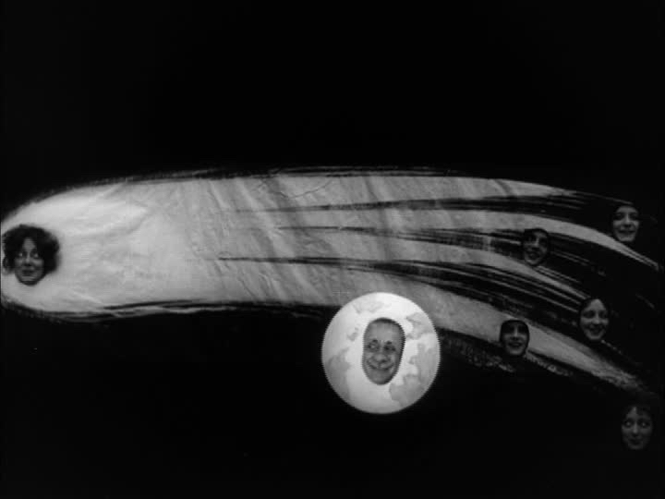
Could there have been an acknowledged handover from Porter and Edison to Thomas? Scenic background films would have had little value for distribution.
The timing of this patent, and the publicized flexing of legal “muscle” protecting it, coincides with the decision of the Edison conglomerate to withdraw from the production of theatrical specialty films. At this time, whatever reputation Thomas had as a “moving picture man” was barely established, so his one patent probably would not have been a threat to the Motion Picture Patent Company, which could have bought out his interests, as they did with individual patent holders of film technology. But could there have been a connection between Thomas and the MPPC’s relinquishing of the specialty film business?
Might Ziegfeld have had personal or professional influence at the Edison Studios? Besides his clients, Sandow and Anna Held, appearing in early Edison films, one of the two known exceptions the Edison Studios made to the “marginal film practices” prohibition was the production of a song film, The Comet (featuring Held and Harry Watson), for Ziegfeld’s Follies of 1910.
With the rise of narrative film form, any theatrical specialty films would have had little value for distribution.
The MPPC did not want its exchanges and distributors making local films. (E.g., Edison affiliate, the Kinetograph Co., is credited in theatre programs with Kliegl Bros. as providing the moving picture effects in 1906 for the Broadway musical The Vanderbilt Cup.) Such filmmaking was prohibited after 1908.
Syndicate theatres were needed for motion-picture bookings. Members of the newly forming motion-picture conglomerate, circa 1907-1908, might have decided the theatrical specialty film business was not extensive or lucrative enough to hold onto once there was a patent and possible Syndicate backing to challenge the kind of background scenery effects that comprised a sizable portion of the already small sideline business of films for multimedia performance.
Looming behind Ziegfeld, were the larger legal “muscles” of the Theatrical Syndicate—the trust of theatre managers and booking agents which centralized, standardized, and controlled the business of theatre. (Perhaps a consolidation model for the fledgling American motion-picture industry?) For nearly a decade and a half, the Syndicate operated as a monopoly until the Shubert brothers broke its control in 1910 and established their own domination.

Slide 16
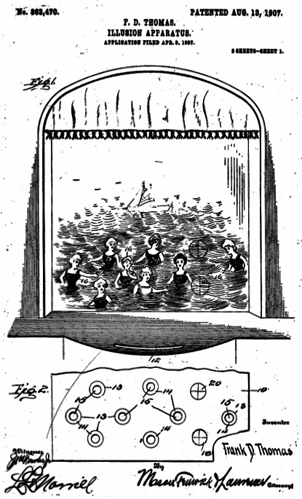
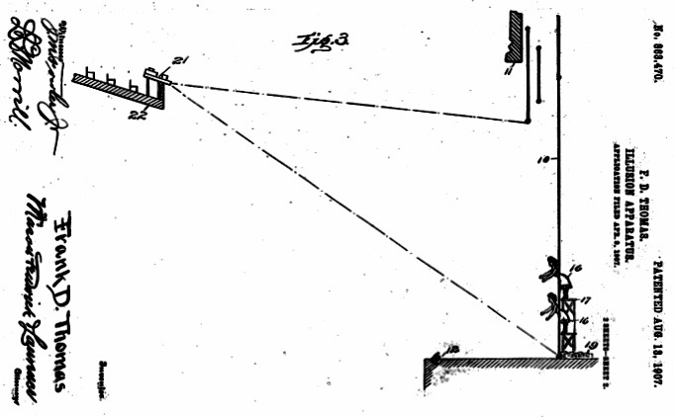
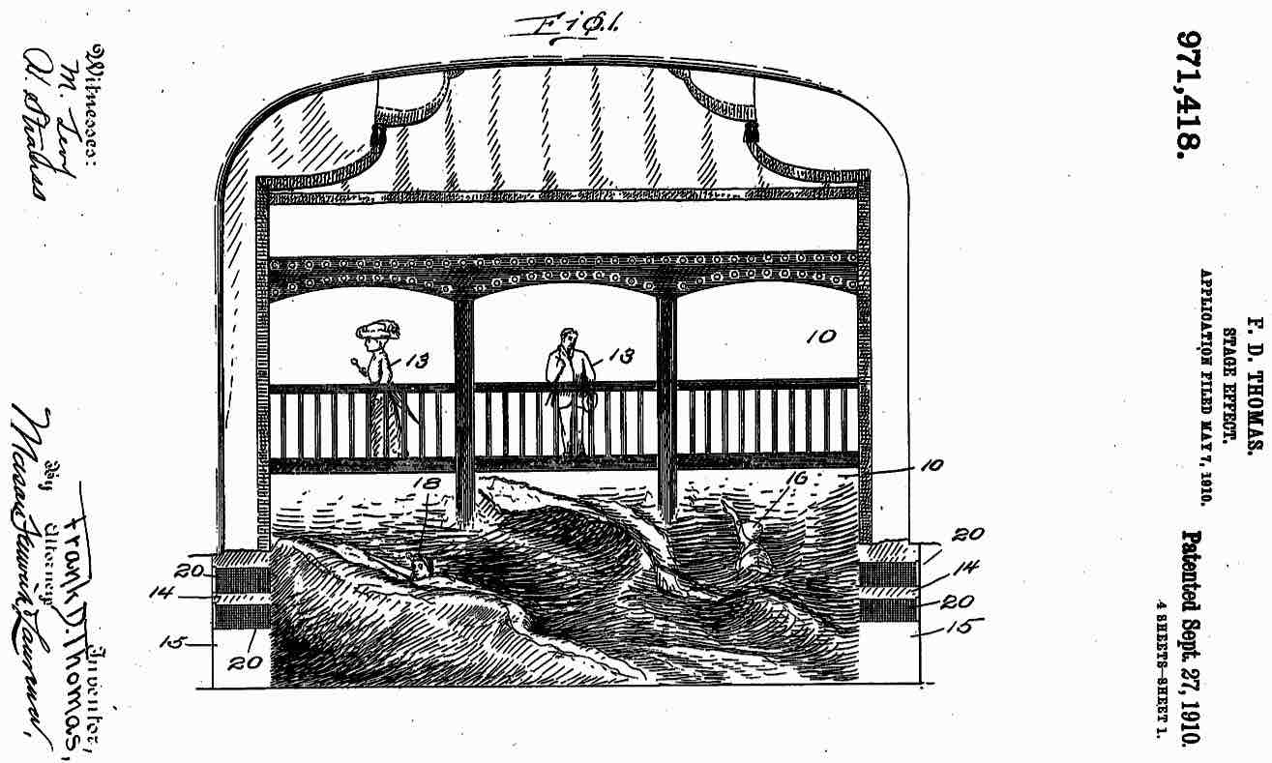
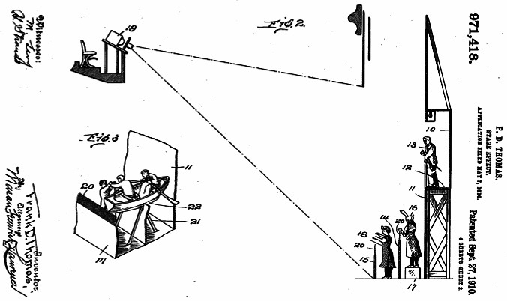
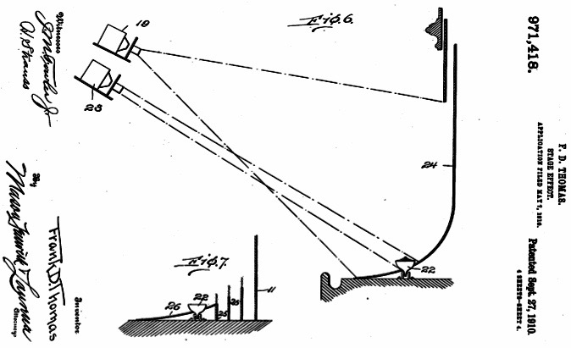
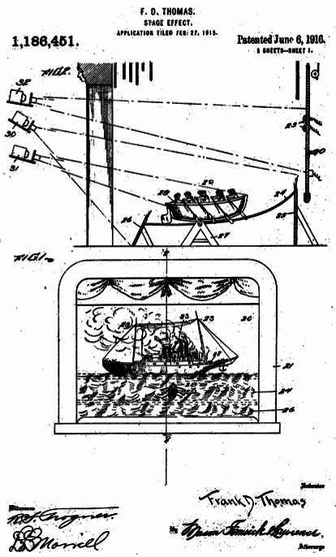
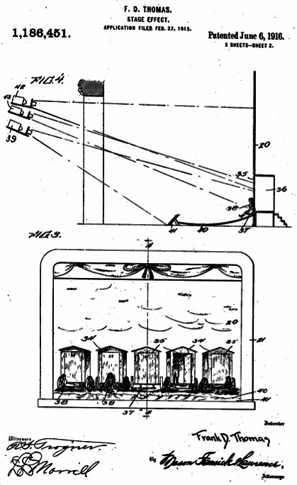
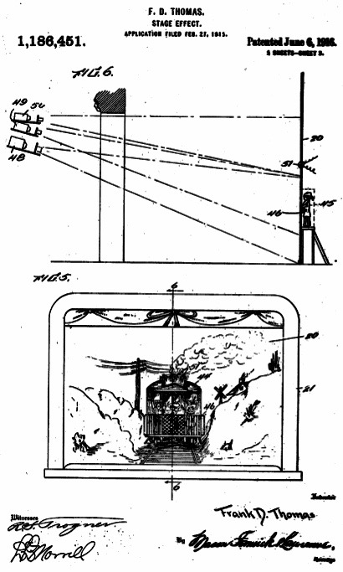
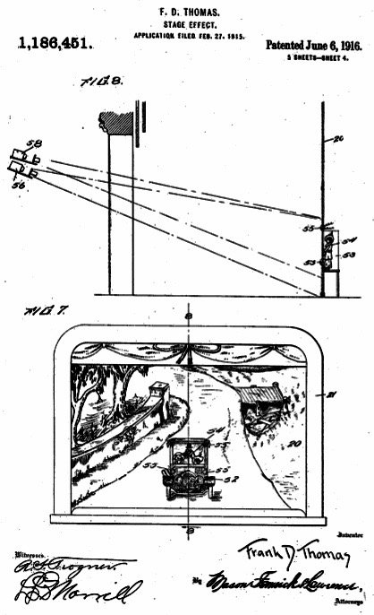
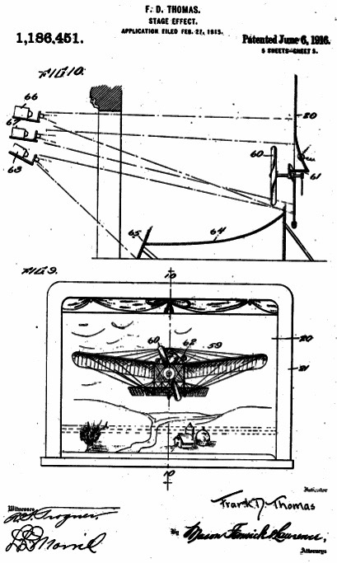
Filmed scenery was used in the theatre as early as 1898 in Lincoln J. Carter’s Chattanooga, directed by Oscar Eagle, and other inventors received patents in the U.S. for filmed effects for simulated travel scenery in amusement rides (beginning in 1905), and—following Thomas—for the stage in the 1910s. Although not all of his effects were for
multimedia scenery, this format was the source of Thomas’s three patents, issued in the United States in 1907, 1910, and 1916. These consisted of a white rear screen (sometimes with foreground elements painted in color) that had openings for actors, various groundrows or groundcloths, motion-picture and stereopticon projectors, and spotlights.
1907
See also Waltz, “Filmed Scenery on the Live Stage”
https://www.jstor.org/stable/25069915?seq=1
US Patent
863,470
1910
US Patent
971,418
1916
US Patent
1,186, 451

Slide 17
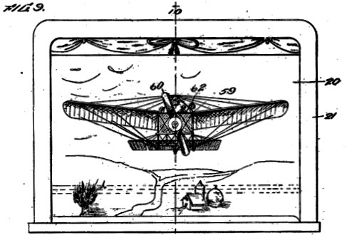
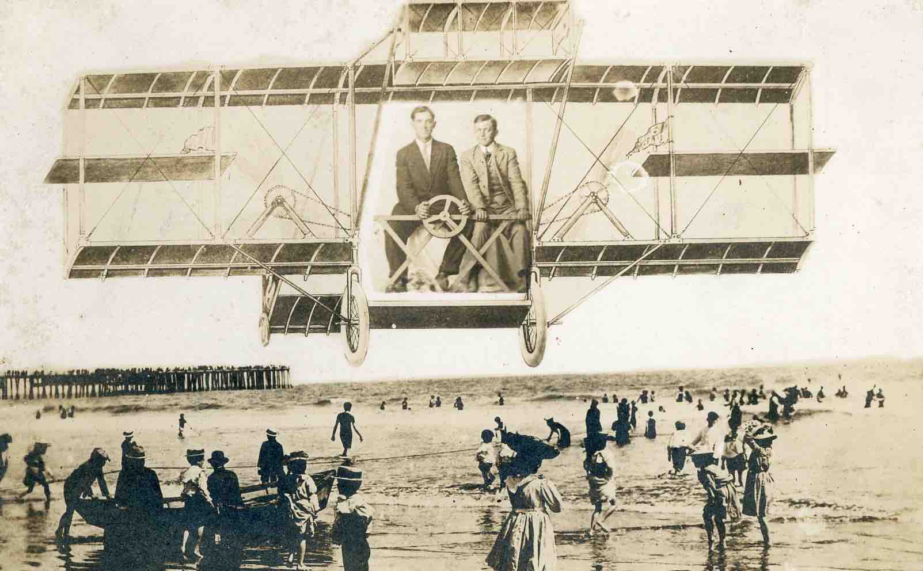
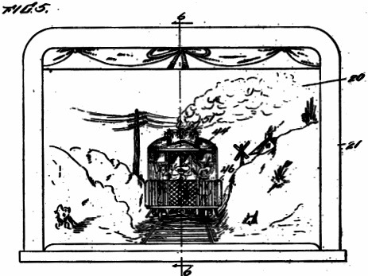
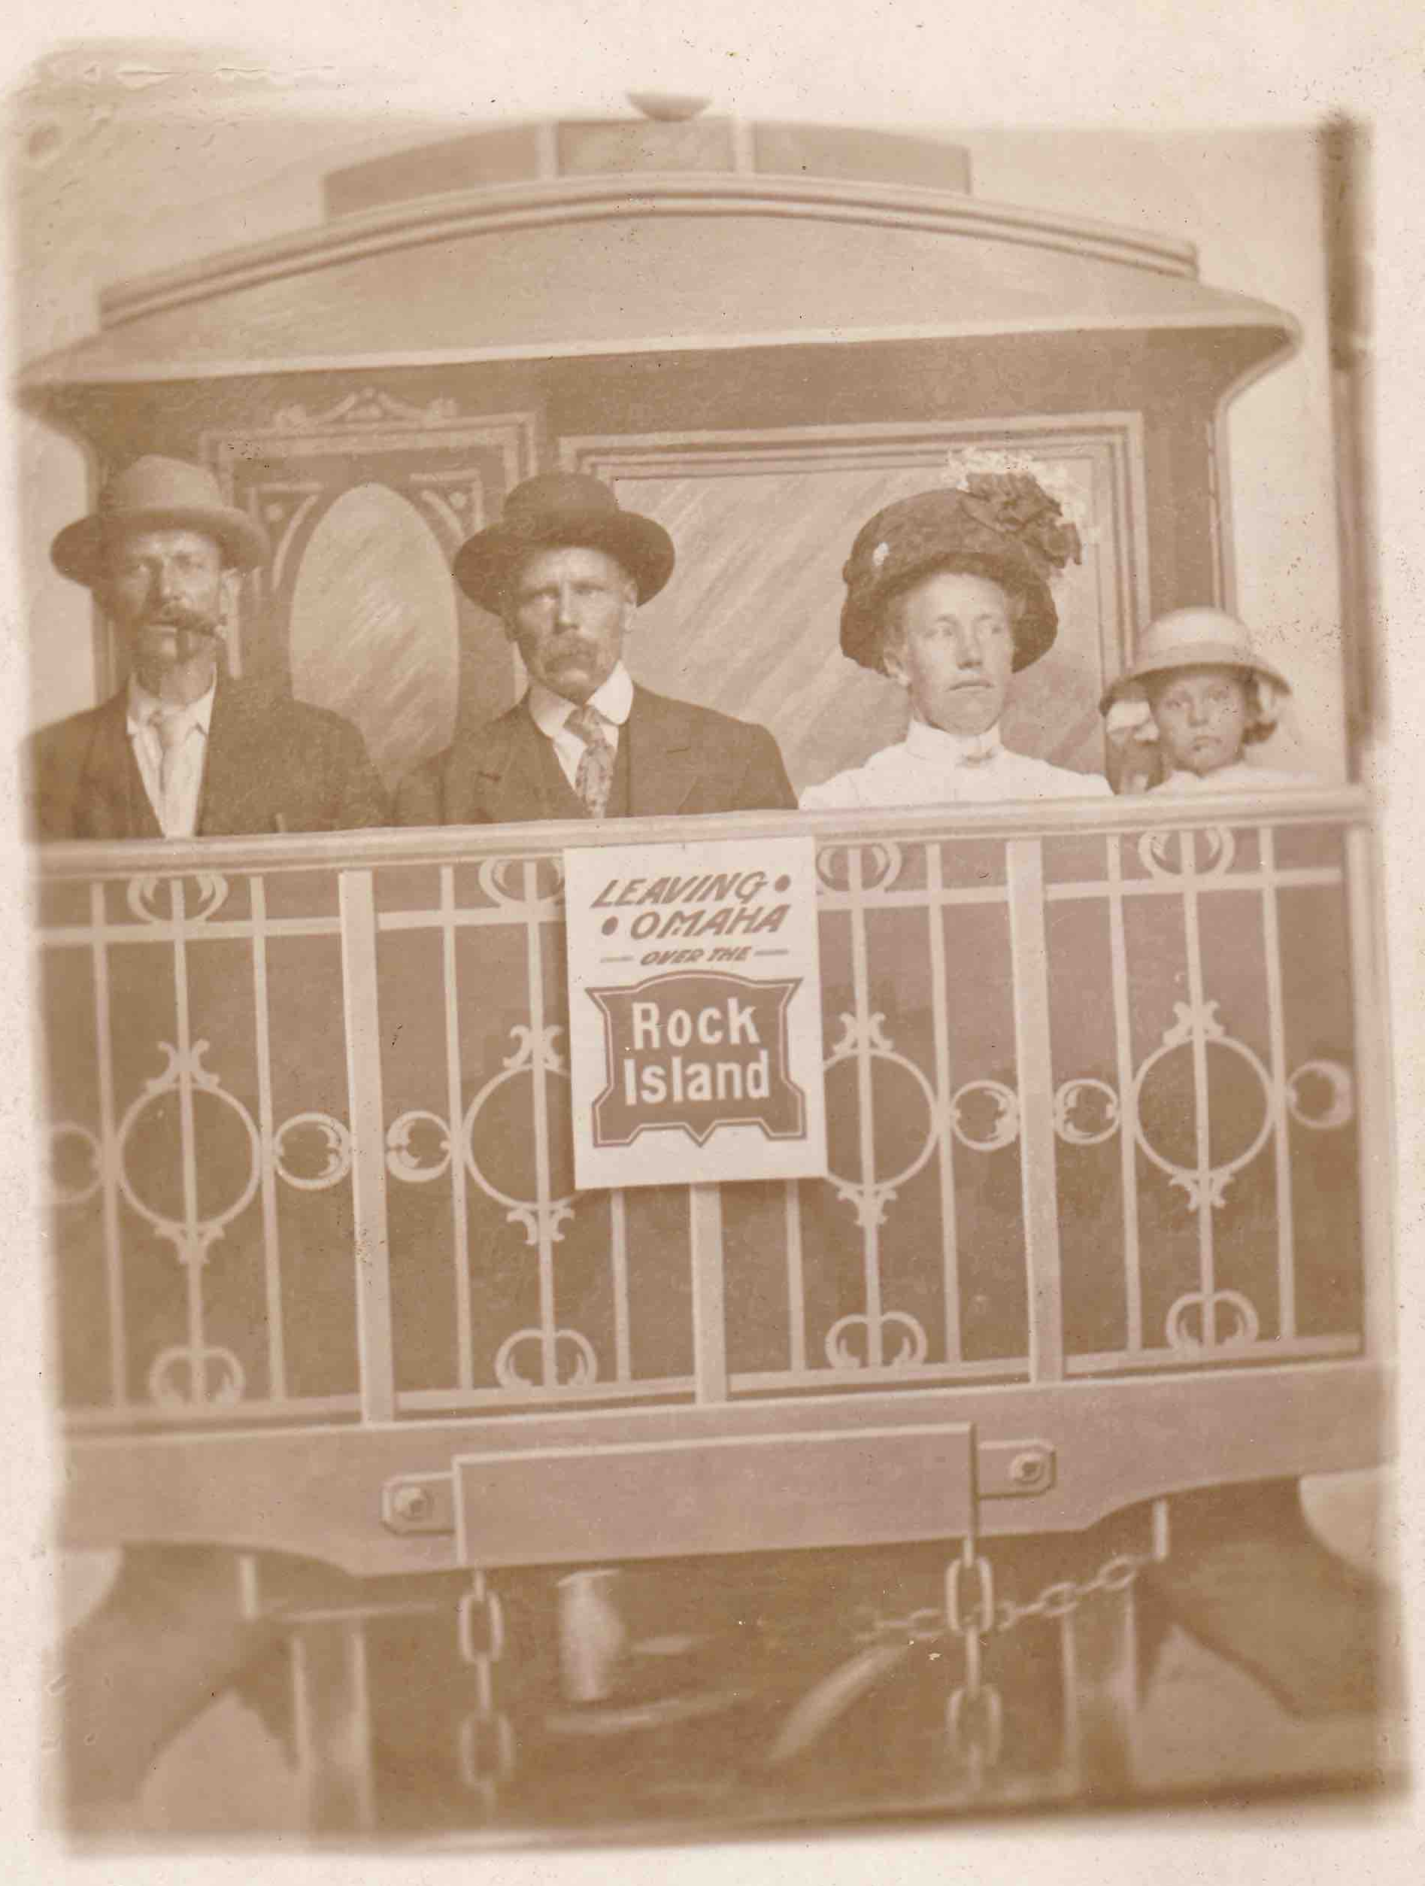
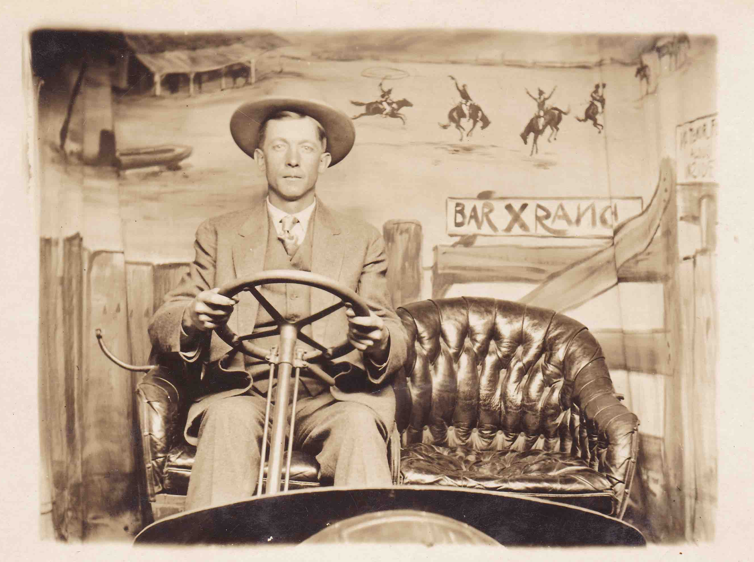
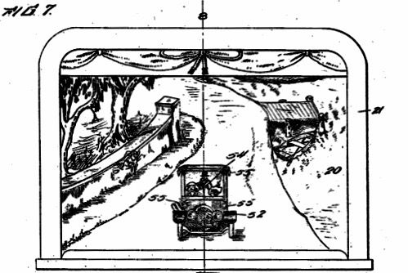
In addition to scenic stage precedents, such as moving panoramas, the image compositing aspects of his filmed backgrounds (live performers layered with moving images) may have had photographic and magic lantern roots. Thomas’s patent illustrations look strikingly like studio prop
postcards, popular in arcades and tourist destinations beginning in the 1870s. Visitors entered a fantasy, humorous, or realistic scene created by a photographer, sometimes donning costumes and props, often standing or sitting in a vehicle. Even the compositions of postcard settings and
Used with permission of the Christopher B. Steiner Collection
the illustrations for Thomas’s patents echo one another.

Slide 18
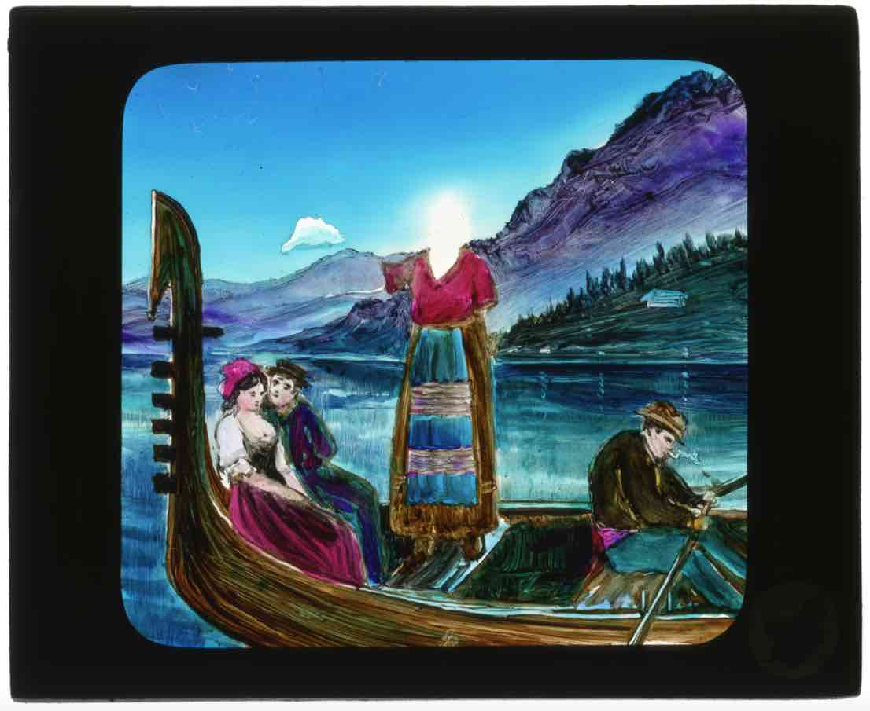
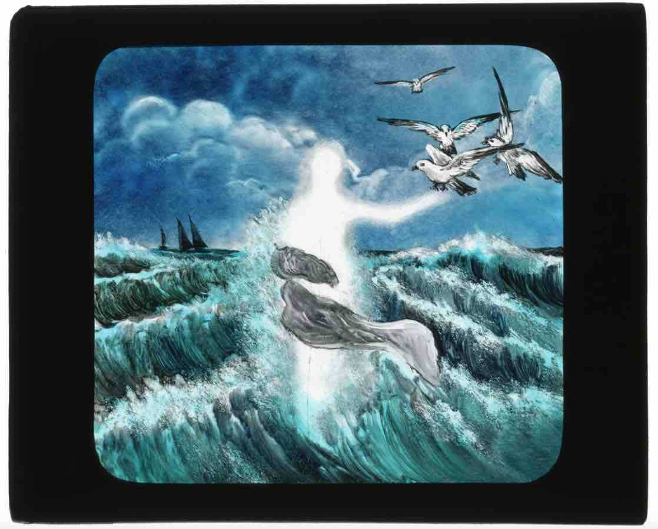
Similarly, at the turn of the century (and for several decades beyond), “pose slides” and “living picture postcards” in magic-lantern shows positioned performers within projected slide scenes. The Joel E. Rubin Collection at The Ohio State University, has examples made by the Kliegl Brothers, whose Universal Electric Stage Lighting Company became the largest 20th-century U.S. supplier of electrical stage equipment and lighting instruments for stage and screen.
“Love at the Helm” and “Venus Rising From the Waves”
pose slides, 1890
The Ohio State University. Jerome Lawrence and Robert E. Lee Theatre Research Institute. Joel E. Rubin Collection. Glass magic lantern slides. Hand-painted Kliegl Bros. “pose” slides. JOR.3.1.46. Slide C9 and JOR.3.1.52. Slide C18.
https://kb.osu.edu/handle/1811/56694
and https://kb.osu.edu/handle/1811/56701
Frank Thomas was no stranger to magic lantern and “electrical effects.” Many New York stage productions featured Kliegl effects, including moving images (panoramas, clouds) projected by stereopticons—a projection instrument Thomas used to enhance his motion-picture scenery.

Slide 19
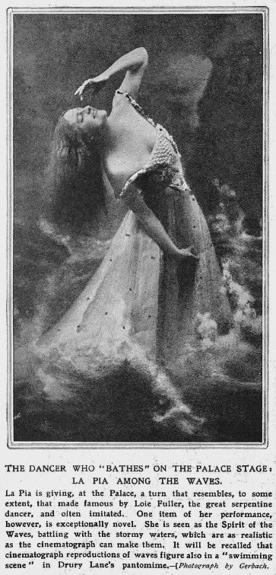
In fact, Thomas appears to have worked directly with a well-known lanternist, perhaps ensuring that his patent rights were observed, but possibly enhancing or replacing a preexisting effect. In 1910 it was announced in the Music Hall and Theatre Review that Frank D. Thomas had “secured” La Pia “for an ingenious dance to be called ‘The Spirit of the Waves’” (also known as “The Sea Nymph,” and “The Dance of the Sea”). La Pia (Ada Stafford) was the sister of De Dio (Florence), both British serpentine dancers. De Dio’s husband, Percy H. Boggis, had been a lanternist and stage electrician for Loie Fuller, and after his 1896 marriage he created lighting and projection effects for each of the sisters.
According to an article discovered by Stephen Bottomore, in 1898 De Dio used a “cinematographe” in a dance produced by Boggis. In 1909 La Pia was performing “The Bathing Dance,” a “bioscopical” piece that may have been a precursor to “The Spirit of the Waves.” It would seem that Boggis and Thomas collaborated on the 1910 effect, adapting Thomas’s 1907 surf bathing to a more dramatic storm scene. The Indianapolis Star published a publicity story about a location shoot, during which tumultuous waves were filmed along the rugged coast of Cornwall, and “nearly drowned” the “bioscope man,” Boggis, and La Pia’s brother, ruining all but enough film “to produce the wonderful effect for La Pia’s closing dance.” This was colored by green lights, and was performed internationally in the following years, sometimes on the same variety bill as the “Surf Bathers” act of the (London) Palace Girls , which presumably involved Thomas’s effect.
“In what is said to be La Pia’s most brilliant dance, the stage seems to be transformed into a raging, seething sea. The breakers roll thunderously against a resisting rocky shore . . . La Pia appears like a veritable water nymph, riding gloriously upon the crest of the waves, making for the shore. Back and forth she is tossed by the mighty torrent. One moment she is seen bravely battling with angry waters and the next she is submerged in the embrace of the great foam-capped billows, . . . until at last, unable to buffet longer with the relentless breakers, she is swallowed up a prey to old Neptune’s fury.”
(NY Dramatic News 26 March 1910)

Slide 20
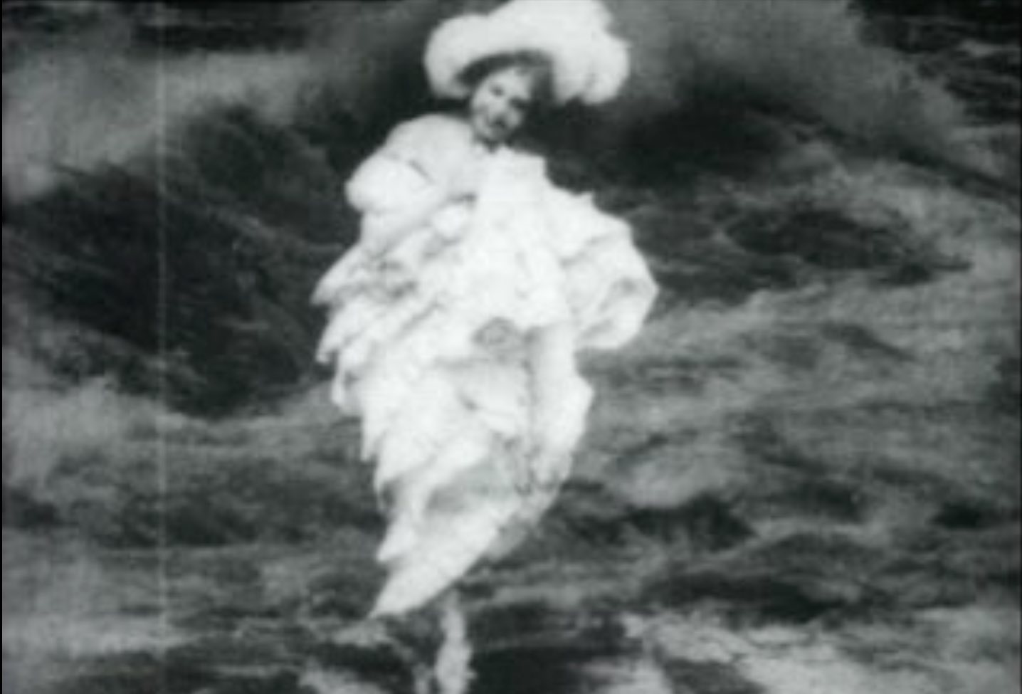
The American Mutoscope and Biograph film, A Nymph of the Waves (1903)—an image composite of two earlier films (one of dancer Cathrina Bartho and the other of the Upper Rapids of Niagra Falls) that is attributed to F.S. Armitage—might give us an idea of what Thomas’s wave effects looked with an onstage dancer.
A Nymph of the Waves
Variations of Thomas’s surf bathing effect appeared world-wide for a decade in at least a dozen productions, including at the Folies-Bergère (circa 1907-1908, contemporaneous to Georges Méliès’s films made for multimedia use). Performers who already had appeared on film for Edison Studios were involved in at least two of these: Annabelle Whitford Moore (Annabelle dance series) in Ziegfeld’s Follies of 1907, and Joseph Hart (Foxy Grandpa series), who produced a vaudeville act known as “The Bathing Girls of Trouville” or “Joseph Hart’s Bathing Girls” (circa 1909-1911) .
Jesse Lasky’s 1909-1910 vaudeville playlet, “The Twentieth Century” (or “Twentieth Century Limited”) showcased Thomas’s express-train observation platform . . .

Slide 21
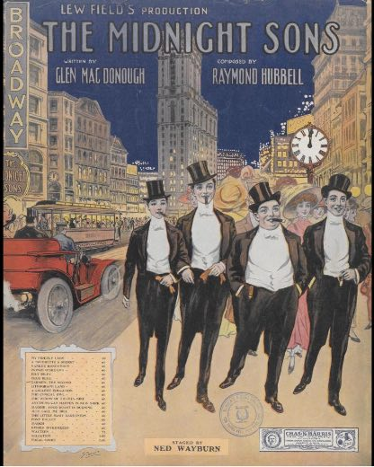
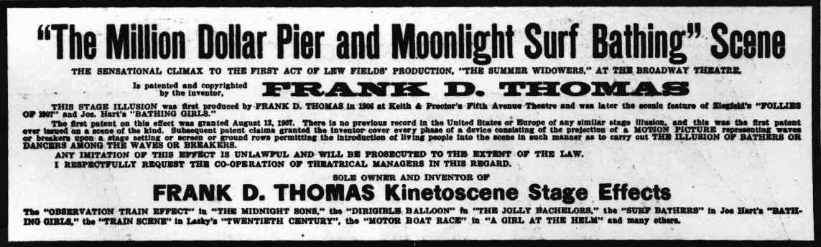
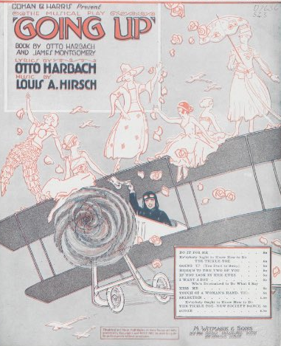
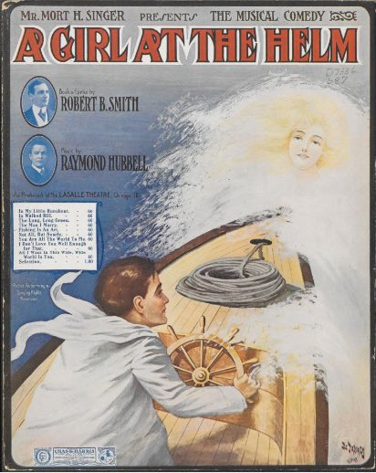
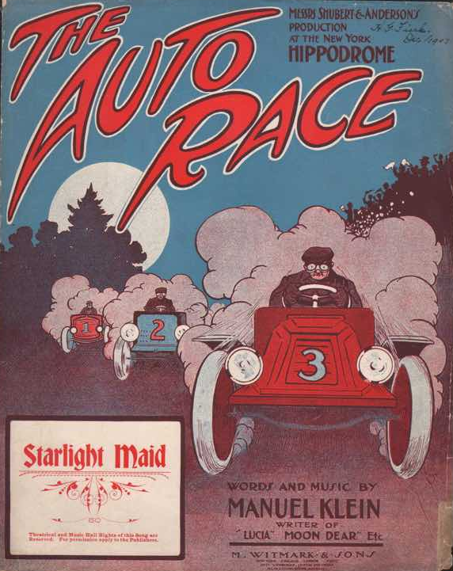
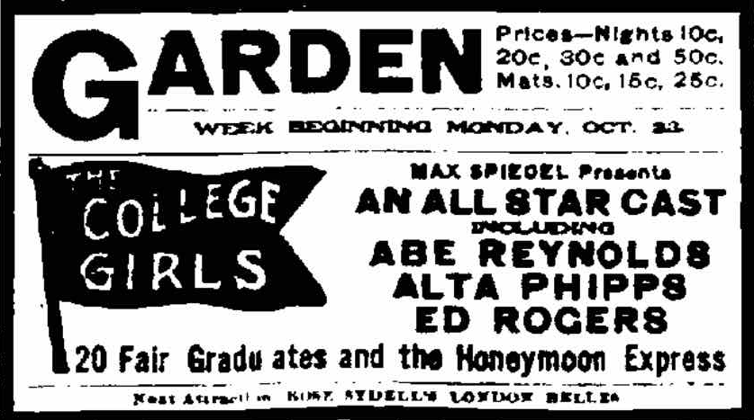
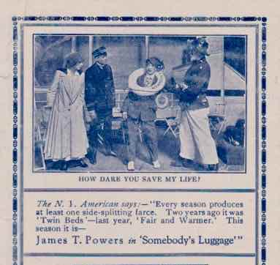
. . . “whizzing through the country at 60 miles an hour, with the entire company assembled on the platform waving and singing as the car apparently is passing through villages, over mountains, dashing through tunnels and sweeping across the plain.” This effect appeared in many incarnations, such as the “Honeymoon Express” scenes in The Midnight Sons (1909-1910), The College Girls (1911), and a “Honeymoon Express” variety playlet that combined three of Thomas’s film effects and toured the U.S. and U.K., 1913-1915.
Thomas’s kinetoscenes included: *travel by dirigible balloons, airplanes, row boats and steamships, *races involving autos, trains, yachts, *floods, *lifeboat rescues, *the San Francisco fire, *an “el train” on the Brooklyn Bridge, *Atlantic City’s Million Dollar Pier, *European seaside bathing machines . . .

Slide 22
. . . *WWI battles at sea and in the air . . .

Slide 23
. . . and *the sinking of ships and submarines.

Slide 24
Between 1906 and 1921, Thomas’s film effects were seen in the U.S., Europe, and the U.K. and its colonies. So far, close to forty productions have been identified.
Magic lantern historian, Ted Barber, catalogued materials about Thomas at the Shubert Archive and was the first scholar to publish and lecture about the inventor’s career. I am indebted to his work, which led me to expand a 1981 seminar paper about stage-and-screen multimedia into a 1991 dissertation and lifelong research focus. I am grateful also for decades of curatorial and staff support from members of the Shubert Archive—wishing this valuable research institution the best in recovering from hardships imposed by COVID-19.
X. Theodore Barber, “Scenic Effects Using the Motion Picture,” The Passing Show (Summer 1984), pp. 2-3

Slide 25
Thomas did not merely invent film effects; he constantly upgraded them and organized a business to place them in theatres. Shubert Archive materials provide information about this. Adopting a model used by early film exhibitors (and, later, Kinemacolor), Thomas sent one to three company-trained motion-picture projectionists along with projectors and films to each performance. The majority of his known effects were for Shubert shows. Lighting operators usually could be rehearsed and relied upon to operate the stereopticon machines that provided visual layering to the filmed images.
Stage carpenters built projection surfaces to Thomas’s specifications. Thomas also designed other visual and auditory components of his effects, which the theatre supplied along with stage equipment and a sheet iron “picture machine booth” requiring four feet of space in the front of the balcony. In a letter dated 19 May 1914, Thomas recommended the Sharlow Brothers on 42nd Street, who made and sold fireproof booths for approximately $100. The films ran from one to over ten minutes, and several newspaper articles mention Thomas as involved in location shooting, although it is not clear who worked the camera.
Effects were rented by the week, usually for a guaranteed length of time (such as thirty weeks) in order to recoup the cost of filming, pay the camera operator(s) and other employees, cover business expenses, and make a profit. Weekly rentals varied from show to show (depending on complexity) and year to year, with Thomas’s asking price ranging from $100-$175 in New York City. Touring cost more—such as $250 for two projectionists in 1915—because of travelling expenses, but these charges might be renegotiated for weeks in which there were fewer than ten bookings, or when business was bad or a show closed early. A world market was necessary to keep the business afloat, and the close to forty identified productions must be only a small portion of the total number of Thomas’s effects used in the fifteen years his trade lasted. This suggests “orphan” effects films by Thomas could survive.

Slide 26
The removal of MPPC studios as a theatrical resource may
have affected multimedia output from 1909-1911, when the number of (known) U.S. productions dwindled, except for those with Thomas’s effects.
From 1912 on, however, multimedia productions increased, utilizing a variety of formats, but filmmakers were not always credited (or are
yet to be discovered). Who were they?

Slide 27
Some films were brought to the U.S. with multimedia performers or theatre companies touring from abroad, but might MPPC employees have taken on occasional work in an uncredited capacity? Did theatre producers use non-MPPC or freelance camera operators, or maybe their own employees? If so, could filling in filmmaking gaps left by the MPPC have made later ventures by the Shuberts and other Broadway producers in (short-lived) film companies seem more feasible?
Associated professionally with Edison, the Kliegl Brothers Universal Electric Stage Lighting Co. was involved in filmmaking before 1908, with two identified productions: The Vanderbilt Cup (1906) and The Rogers Brothers in Panama (1907). A swimming effect from the latter show—along with two other films from unidentified productions—was still offered for rental in 1913, which suggests the effects may have had a continuing commercial demand. Kliegl’s role in the history of projected entertainment, from lantern slides to effects for motion pictures, is a topic waiting to be examined.

Slide 28
Before its 1913 licensing agreement with the MPPC, the Kinemacolor Company of America attempted to gain a foothold in the U.S. by engaging the interest of stage producers. John J. Murdock (later with RKO Pictures)—who with the International Projecting and Producing Co. had opposed the MPPC in Chicago before working for Keith-Albee—established distribution in Shubert theatres and elsewhere after acquiring
U.S. Kinemacolor rights in 1911. Henry J. Brock furthered theatre relationships when he became president of the company in 1912. In a letter dated 23 April 1912 (Shubert Archive), he asked Lee Shubert
Additional photos of dance hall film screen (seen in image above)
https://collections.mcny.org/CS.aspx?VP3=SearchResult&VBID=24UP1G6J4MBC&SMLS=1&RW=1096&RH=920
to “consider our taking some of the Shubert stars in portraiture in Kinemacolor,” on and off the stage, as promotional pictures beneficial to all—an idea which led
to the “Famous Players at Home” series (1913-1914) and filmmaking with Broadway actors.
Additionally, Kinemacolor provided motion picture effects for at least three multimedia productions: The Girl from Montmartre and The Lady of the Slipper in 1912, and Who’s Who in 1913, as well as film sequences for Lillian Russell’s “Health and Beauty” lecture tour, “How to Live a Hundred Years” (1913).
Reproduced color for Russell Kinemacolor fragment
https://www.youtube.com/watch?v=zQSJKCkZ8sI

Slide 29
With the weakening and dissolution of the MPPC in the mid-1910s, film companies once again took on occasional sideline work, making films for multimedia purposes. For instance, Lubin produced a Méliès-esque colored film for Chin-Chin (1914) of Montgomery and Stone falling from a flying magic pagoda and landing on the crescent of a displeased Man in the Moon.
That same year, Frank Thomas provided a boat race and auto pursuit effect for William Brady’s Life, but the seven, 2-to-7½-minute-long “Illustrated Intervals” between scenes, which continued the action of the play via moving pictures, were made by Peerless and Universal.
From the mid-1910s to mid-1920s, exploration of multimedia formats was reciprocated by film companies in live-action prologues or dramatic segments mounted with actors and scenery. Eventually, these were handled by indivual theatres or troupes.

Slide 30
Doubling back to pick up the skein of relationships discussed at the beginning of this presentation, we see them separating along the professional division generated by the MPPC, between the more medium-specific approach of the motion picture studios and the novelty-hungry and sometimes intermedially-curious ventures of theatre producers and performers.
George Layton continued to work with Frank Thomas after Spook Minstrels. A 1918 Philadelphia Evening Ledger article states “they jointly created the most striking scenes in ‘The Follies,’ ‘The Whirl of the World,’ ‘Somebody’s Luggage,’ ‘[Mr.] Hamlet on Broadway,’ Lew Field’s ‘Midnight Sons,’ ‘Summer Widowers,’ ‘Sun Dodgers,’ ‘All Aboard’ and numerous Winter Garden offerings,” as well as then-current effects for Going Up and Seven Days’ Leave, the latter with which both Layton and Thomas travelled—in England and the U.S.—to supervise the effects. Layton was also manager of The Deluge in 1911.
In 1922 he handled the correspondence between Thomas’s company and J.J. Shubert, as well as a patent infringement suit against Arthur Hammerstein for one of two film effects used in The Blue Kitten. Since Layton and another person are named as “assignees” of the patent, and Thomas’s letters to the Shuberts appear to end after 1921, it may be that Thomas retired, was ill, or had passed away by 1922.

Slide 31
Jean Havez was involved intermittently in Thomas’s work. It seems his signature was garbled as a witness to the texts of the 1910 and 1916 patents, incorrectly transcribed by a patent official as “Jean C. Haney” and “Jean C. Hanez.”
Variety reported in 1913 that Thomas imported an effect from Germany for Havez’s first wife, Cecile Cunningham, an operetta performer who was “going out in a singing act assisted by six show girls” in vaudeville. This was an “electrical illusion” that changed “to the four different seasons of the year.” The act apparently was “The Married Ladies Club,” a musical playlet written by Havez and George Botsford.
Havez conceived “Curse You, Jack Dalton” (©1914) in a multimedia mode unlike Thomas’s. This satire of film melodrama was a vaudeville vehicle for several actors, beginning with Jack E. Gardner, who—live, onstage—interacted with the characters in a motion picture. Imdb.com credits Hippo Film Company with a film of this name (1916), but I have not been able to verify this.

Slide 32
Although I have discovered no connection between Thomas and Edwin Porter beyond Spook Minstrels and Lew Dockstader, it is interesting that around this time, circa 1907, Porter and Norman O. Dawn were experimenting with image compositing, using glass matte effects. At this time, Dawn also was working for Hale’s Tours, shooting what essentially was another type of filmed scenery.
In addition, it was in 1907 that J. Searle Dawley began working at the Edison Studios under Porter. Dawley retained his theatre connections with Edna May Spooner and Charles Blaney, her husband. Blaney presented behind-the-screen “talking pictures” on the Spook Minstrels model at his Third Avenue Theater in 1908, when this combined live-performer-and-film mode of performance became a fad across the country. Multimedially, Dawley additionally had experience creating an electrical effect similar to a pose slide for Spooner in 1902 (evidently involving moving lantern and stereopticon effects), and in 1909 in The Girl and the Detective, a play written by Dawley and Blaney, the opening scene was established with a film.
Considering that these people all were in New York during the same period, had dealt with the Edison Studios and Porter, and commonly shared an interest in image compositing, it is tempting to envision an opportunity ripe for “talking shop”—
one which, we might hope, was taken and enjoyed. The professional line of separation drawn by the MPPC need not have prevented the friendly interchange of ideas.

Slide 33
In the decade that followed, Dawn, Thomas, and Dawley examined the challenges of rear projection. In 1912, for the motion picture Ghost of Thunder Mountain, Dawn filmed photographic stills projected behind a glass screen, but turned his attention afterward to creating background images with glass shots.
Four years later, Frank Thomas wrote to J.J. Shubert, “I have just finished a new machine capable of projecting the largest ever film which enables me to project from behind stage, securing wonderfully realistic marine effects.” A response and further discussion of this machine and its film stock do not seem to have survived. Therefore, details about the gauge and provenance of the film stock, the workings of the projector, and how Thomas addressed problems of focal length remain tantalizingly out of reach—nor is it clear if he attempted rear projection in later effects.
Screens for rear-projected motion pictures were available in the 1910s, but, as a 1914 article in The Bioscope explained, image definition was tricky. A greater problem was the behind-the-screen space needed for projection. For instance, the Bioscope author points out, a two-inch lens required 27 feet of space to throw an 18-foot picture (not including another five feet for the projector and operator). Even with improved lenses, because of the backstage traffic in any stage production, rear projection was rarely a practical option before digital solutions were adopted in recent decades.

Slide 34
J. Searle Dawley patented an invention for filming still photographic images that were rear projected (1918), but it was not until the 1930s, when the shutter speeds of a projector and camera could be synchronized, and improvements were made in film stock and projector lamps, that rear projection for filmmaking became feasible.
In Austria and the U.S., in 1929, Stephan Jelinek
patented his own approach to rear projection’s obstacles. His patent is important to this discussion because he acknowledges a connection between—and influence from—projected scenery on the stage and rear projection for filmmaking.
→
At a Domitor conference nearly twenty years ago, Tom Gunning posed a friendly scholarly challenge to me to search for a “missing link” when I suggested that Frank D. Thomas’s filmed scenery might have influenced the development of rear projection for backgrounds in motion pictures. I thank him for launching me in new directions. If not a sure link, I have found a chain of relationships, which also connect to the filmmaking gap created by the Edison Trust, involving people who filled it.

Slide 35
Hello—bonjour—my colleagues,
I look forward to your presentations and conversations with you, as well as to any suggestions and information you might provide in response to my presentation.
Be safe and well!
Gwen
gwendolynwaltz@gmail.com
I also invite you to peruse the following slides and links as an entertaining postscript, taking Thomas’s concepts into the 21st century. . . .

Slide 36
Thomas’s projection concepts live on—perhaps most excitingly in a production of Mozart’s The Magic Flute, an approach to the opera using interactive animation, conceived by Suzanne Andrade and Paul Barritt of 1927 (a multimedia performance group in the U.K.), staged with Barrie Kosky as a production by the
Komischen Oper Berlin and the Deutschen Oper am Rhein, and subsequently reproduced internationally. As in Thomas’s design, a white background was used for projection, and performers appeared through the screen (here on turntables) or stood behind waist-high half-cylinders, similar to Thomas’s groundrows, which cleverly integrated the actors’s bodies with animated films.
1927 ABOUT tab: https://www.19-27.co.uk/1927
See also FILM and STAGE SHOWS tabs.
Christie Conover (Minnesota Opera singer)
“Behind the Scenes Magic Flute Rehearsals”
YouTube video post, 17 October 2015
https://www.youtube.com/watch?v=Z0U1DKOSazs

Slide 37
In these photos the half-cylinder projection surface is demonstrated at a Minnesota Opera lecture, and, in video stills, we see how this, the screen, and turntables were used in the German production.
Deutsche Opera am Rhein
“Die Zauberflöte”
YouTube video post, 16 December 2013
Commentary by Barrie Kosky
https://www.youtube.com/watch?v=i-XEFUImCJ8&list=PLQpAZ9J3wEsnycMWs-iHBhgnuqSWH7DsS
Minnesota Opera
“Behind the Scenes Magic Flute Rehearsals”
YouTube video post, 7 April 2014
https://www.youtube.com/watch?v=QpgI_opQG-4
For demonstrations, see 49:40-58:00

Slide 38
Techniques from “pose slides” also were employed.
“A Lobster” [#1] and “The Spider’s Web”
pose slides, 1890
The Ohio State University. Jerome Lawrence and Robert E. Lee Theatre Research Institute. Joel E. Rubin Collection. Glass magic lantern slides. Hand-painted Kliegl Bros. “pose” slides. JOR.3.2.33. Slide A77, and JOR.3.2.66. Slide F10.
https://kb.osu.edu/handle/1811/56678
and
https://kb.osu.edu/handle/1811/56728

Slide 39
Here, an audience volunteer at the Minnesota Opera’s lecture is shown how the singers learned the timing and body placement to “interact” with animated characters. Frank
Thomas mentioned an idea for a “Moving Picture
Comedy effect . . . With a dancing comedian” and
live chorus in a letter to J.J. Shubert
dated 4 January 1917 (Shubert Archive).
A number of interactive
multimedia acts involving
live actors and filmed
characters were seen internationally, first in the early 1900s in vaudeville and music hall acts, then as a cluster of performances in the mid-1910s. Hand-drawn animated characters were introduced to multimedia acts, including Victor Forsythe’s Flooey and Axel in an El Ropo cigar sequence used by a comedian (1915,
Komic Pictures/Mutual), as well as Winsor McCay’s interaction with Gertie the Dinosaur (1914). In 1925, Max Fleischer’s daughter, Ruth, performed in an “Out of the Inkwell”-style dance act at New York movie theatres, animated by her father, that showed her giving a Charleston lesson to him and Ko-Ko the Clown (“Ko-Ko Steps Out,” Red Seal).
**FINIS**

